Slide 1

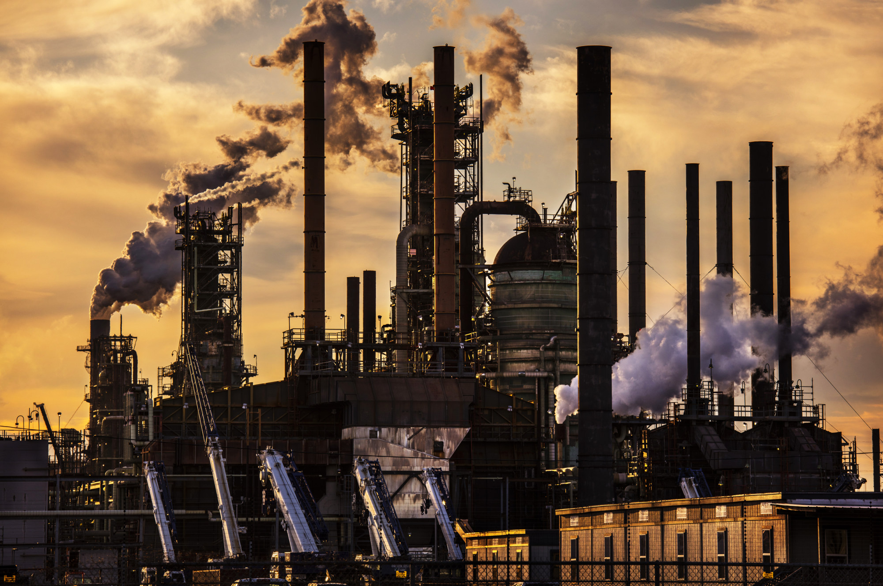
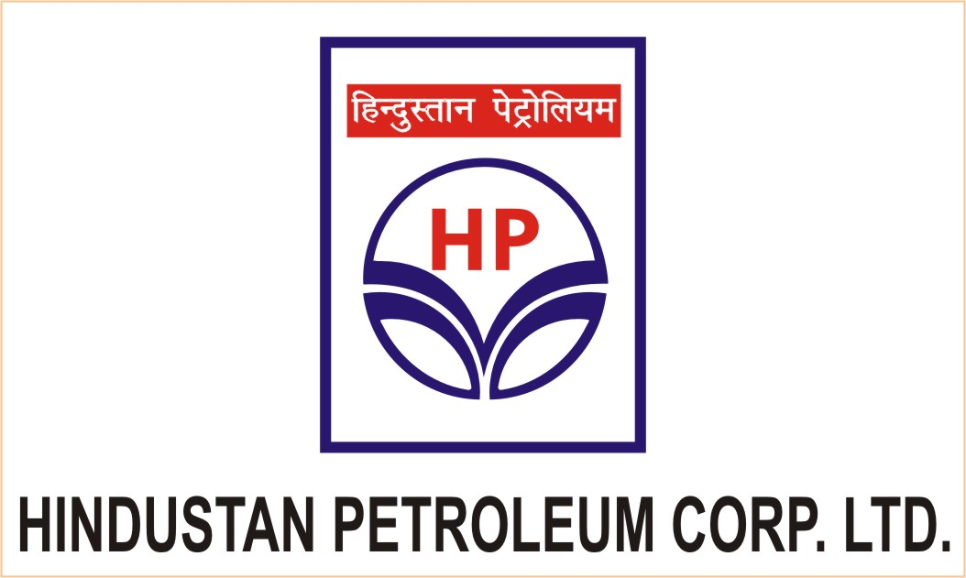
2015 – 2040
INDIA CARBON DIOXIDE MARKET
FORECAST & OPPORTUNITIES
Prepared for :
MARKET INTELLIGENCE . CONSULTING
www.techsciresearch.com

Slide 2
Market Overview: India Carbon Dioxide Market
India Carbon Dioxide Demand, By Volume, FY2015, FY2021, FY2022E and FY2040F (Tonnes)
India Carbon Dioxide Capacity, By Volume, FY2015, FY2021, FY2022E, FY2040F (Tonnes)
The demand of carbon dioxide is anticipated to reach the 4269.09 thousand tonnes in 2040 due to increasing demand from the end-user industries which includes the demand from food & beverages industry as liquid carbon dioxide is used in producing in the soft drinks and dry ice is used to maintain the quality of perishable foods products during storage and transport at distant locations.
Currently the carbon dioxide capacity in India stands at 3810 thousand tonnes in FY2021. The top 5 companies includes Punjab Carbonic Private Limited, SICGIL India Limited, Indian Farmers Fertilizer Cooperative Limited, Southern Petrochemical Industries Corporation Limited, and Bathinda industrial Gases Pvt. Ltd. (BIGPL).
India Carbon Dioxide Market Share, By End User Industry, By Value, FY2022E
India Carbon Dioxide Market Share, By Region , By Volume, FY2021
Food & beverage industry is the largest end use industry for carbon dioxide, as liquid carbon dioxide is used in carbonation of aerated beverages and large quantity of dry ice is used for maintaining quality of perishable food products during storage or transport at distant locations. Growing advancements in healthcare sector of the country is boosting vaccine and medicines production and this is in turn increasing demand for dry ice for the transportation of these healthcare products.
North region dominated India carbon dioxide market and accounted for a volume share of 34.92% in 2021. Owing to presence of leading food & beverage industries lead to growth in consumption of liquid carbon dioxide as well as dry ice. South region is the second largest demand generator for carbon dioxide in India and is expected to exhibit fastest growth in consumption of carbon dioxide through 2040. West region accounted for a volume share of around 24% in India carbon dioxide market and this is expected to grow in absolute terms by 2040 owing to strong industrial growth in the region.
Source: TechSci Research

Slide 3

Recommendations for HPCL
It is recommended that HPCL should focus on export of carbon dioxide as domestic production of the gas is sufficient to cater domestic supply.
HPCL is advised to invest in the liquid grade of carbon dioxide as there are many food & beverages, pharmaceutical, and automotive companies operating in the country where liquid grade is extensively used. The substantial demand growth in domestic end-user industry till 2040 have a potential of setting up a domestic carbon dioxide unit of around 2000 thousand tons.
It is advised to target neighbouring nations such as Nepal, Sri Lanka, Bangladesh, Bhutan, Middle East and African Nations with distribution tie-ups. HPCL can target carbon dioxide export in countries due to growing demand from Food & beverage, Oil & gas recovery applications
There has been a significant progresses through which gaseous carbon dioxide can be converted to valuable products. It is advised to use the gas for captive as there has been development of significant technologies which will convert carbon emissions from large point sources such as industrial facilities and power plants into valuable products such as alternative fuels, building materials and many more

